Slide 1

THE PROSKAUER ROSE LLP CRIME FAMILY

Slide 3
Crime Chart 1

Slide 4
Crime Chart 2

Slide 5
Crime Chart 3

Slide 6
Crime Chart 4

Slide 7
Crime Chart 5 – Cover Up Participants

Slide 8
Proskauer Rose LLP - Robert J. Kafin – Managing Partner

Slide 9
Proskauer Rose LLP - Robert J. Kafin – Managing Director
Alleged Activities
Pending Actions by Iviewit
Patent & Copyright Misappropriations
Co-Directs Frauds: USPTO; EPO; JPO; Wachovia Securities Fraud; Iviewit Shareholder Fraud; (See Shareholder Table)
Contributory Antitrust Violations
Co-Directs RICO Violations
Tortuous Interference with Business Relationships
Conflicts of Interest
FBI Written Statement/Interview
Boca Police Written Statement/Interview
Written Statement to Department of Justice, Antitrust Division

Slide 10
Proskauer Rose LLP - Kenneth Rubenstein

Slide 11
Proskauer Rose LLP - Kenneth Rubenstein
Alleged Activities
Pending Actions by Authorities
Patent, Trade Secret, Trademark & Copyright Fraud
Directs Frauds: United States Patent and Trademark; Small Business Administration, European Patent Office, Japanese Patent Office, U.S. Postal Fraud, Wire Fraud, Wachovia Securities Fraud; Iviewit Shareholder Fraud; Iviewit Investor Fraud (See Shareholder Table), Contributory Antitrust Violations
RICO & SHERMAN AND CLAYTON ACT VIOLATIONS
Tortuous Interference with Business Contracts
Conflicts of Interest – Violations of attorney conduct state of New York and Patent Office
Perjured Deposition
False and Misleading Information to Florida State Court and N.Y. Bar Association
Infringement
Breach of Fiduciary Responsibility Advisory Board Director Iviewit
Breach of Attorney Client Privileges
FBI Written Statement/Interview
Boca Police Written Statement/Interview
New York Bar Complaint
Written Statement to Department of Justice, Antitrust Division
Written Statement to NY County District Attorney
Written Statement to NY State Attorney General
Written Statement to Office of Enrollment & Discipline – USPTO
Written Statement to EPO and JPO

Slide 12
Rubenstein Perjured Deposition
Deposition Rubenstein Affidavit to Court Rubenstein New York Bar Response | Proskauer Rose Patent Billings with Kenneth Rubenstein Kenneth Rubenstein statement to Court of no knowledge of Iviewit
Shirajee Tesitmony contradicting Rubenstein deposition and Bar Statements | Witness Statements Witness Statements

Slide 13
Rubenstein’s Conflict of Interests
MPEGLA – PR client with Rubenstein patent evaluator
DVD Patent Pool - PR client with Rubenstein patent evaluator – See Deposition and Rubenstein response to NY Bar
Proskauer Rose clients
Investors relied on him
Private Placement documents edited, reviewed and disseminated by PR contain Rubenstein as Advisor, also shareholder of Iviewit

Slide 14
Rubenstein’s Patent Misappropriations
Deposition Rubenstein Affidavit to Court Rubenstein New York Bar Response Iviewit Documents showing Rubenstein handling patents, directing patents, maintaining original patent documents, billing records containing Rubenstein entries Business plans disseminated by Proskauer Rose showing Rubenstein as Advisory Board member. Utley Document pointing to Rubenstein as Advisor to Board Witness Statements – Rubenstein was critical to investment in Iviewit Shirajee Testimony contradicting Rubenstein deposition and Bar Statements Show document flow through PR and that Wheeler states that he kept original patent documents. Joao is directed by Rubenstein in patent filings Missing copyrights of sites and source code, billed for by PR | Kenneth Rubenstein statement to Court of no knowledge of Iviewit Wheeler letter to investors regarding Proskauer Rose review of technologies Hassan regarding Rubenstein Proskauer Wheeler letter relating to patent services Rubenstein whereabouts unknown immediately after learning of Iviewit moves from MLGS to PR, letter to Wheeler, who is Rubenstein Directs Raymond Joao who he claims is coming to PR with him from MLGS and Joao’s statement to Bar contradict this. Factually, after meeting with Iviewit, PR buys MLGS entire patent department which specializes in Iviewit niche Rubenstein as advisor to MPEG – COI that is never disclosed since we think he is our counsel, he repeatedly states with Wheeler that the patent pools will soon pay royalties on the Iviewit techs

Slide 15
Tortuous Interference with Business Contracts
AOLTW
WB
Sony – Chey from WB
Paramount
Hollywood.com
Wachovia Private Placement

Slide 16
Christopher C. Wheeler - Proskauer Rose LLP

Slide 17
Proskauer Rose LLP - Christopher C. Wheeler
Alleged Activities
Pending Actions by Iviewit
Patent & Copyright Misappropriations
Contributory Frauds: USPTO; EPO; JPO, U.S. Postal Fraud; Wire Fraud; Wachovia Securities Fraud; Iviewit Shareholder Fraud; (See Shareholder Table)
Contributory Antitrust Violations
Facilitates RICO Violations
Tortuous Interference with Business Relationships
Conflicts of Interest
Perjured Deposition
False and Misleading Information to Florida State Court and The Florida Bar Association
Infringement
Misappropriation and Conversion of Funds
Breach of Fiduciary Responsibility Director Advisory Board Iviewit
Breach of Attorney Client Privileges
FBI Written Statement/Interview
Boca Police Written Statement/Interview
The Florida Bar Association Complaint
Written Statement to Department of Justice, Antitrust Division
Written Statement to Office of Enrollment & Discipline – USPTO
Written Statement to EPO and JPO

Slide 18
Proskauer = Madoff + Dreier + Stanford
Proskauer Rose
Allen Stanford
$7 Billion Fraud
Awaiting Trial in Jail
Marc Dreier
$700 Million Fraud
Convicted Felon
20 YR Sentence
Bernard Madoff
$65 Billion Fraud
Convicted Felon
150 YR Sentence
Proskauer Partner
Thomas Sjoblom
Former SEC Enforcement
Alleged to have coached Stanford
Employees in a Miami airport
Hanger on how to lie to the SEC and FBI
Raymond Joao
Proskauer Rose Referred to Iviewit
Moved to Dreier after discovered
Patenting Invention 90+ in his name
Proskauer has Most
Madoff Clients, many
Clients now Being
Investigated as
Accomplice
Jacqueline Wood
Former SEC cited in
Inspector General
Report of Madoff Failure
As having buried
Information in 2004 that
Would have exposed the
Scheme. After leaving
The SEC Wood took a
Proskauer Partnership
Laura Pendergest Holt
Sues Proskauer After
Arrest in Stanford Ponzi
James Davis – Stanford CFO
Makes Plea Deal and Fingers
Proskauer – Global Class Action
Against Proskauer filed immediately
After

Slide 19
Real 3d Inc. ( Silicon Graphics, Lockheed Martin & Intel ) – SGI US Bankruptcy & MPEGLA Lawsuit
Real 3D, Inc.
Silicon Graphics, Inc.
Intel Corporation
Davis Polk Wardell
Ropes & Gray
Lockheed Martin

Slide 20
Steven C. Krane Proskauer Rose LLP

Slide 21
Steven C. Krane
Alleged Activities
Pending Actions by Iviewit
Patent & Copyright Misappropriations
Contributory Frauds: USPTO; EPO; JPO, U.S. Postal Fraud; Wire Fraud; Wachovia Securities Fraud; Iviewit Shareholder Fraud; (See Shareholder Table)
Contributory Antitrust Violations
Facilitates RICO Violations
Tortuous Interference with Business Relationships
Conflicts of Interest
Perjured Deposition
False and Misleading Information to Florida State Court and The Florida Bar Association
Infringement
Misappropriation and Conversion of Funds
Breach of Fiduciary Responsibility Director Advisory Board Iviewit
Breach of Attorney Client Privileges
FBI Written Statement/Interview
Boca Police Written Statement/Interview
The Florida Bar Association Complaint
Written Statement to Department of Justice, Antitrust Division
Written Statement to Office of Enrollment & Discipline – USPTO
Written Statement to EPO and JPO

Slide 22
Matthew Triggs – Proskauer Rose LLP

Slide 23
Matthew Triggs
Alleged Activities
Pending Actions by Iviewit
Patent & Copyright Misappropriations
Contributory Frauds: USPTO; EPO; JPO, U.S. Postal Fraud; Wire Fraud; Wachovia Securities Fraud; Iviewit Shareholder Fraud; (See Shareholder Table)
Contributory Antitrust Violations
Facilitates RICO Violations
Tortuous Interference with Business Relationships
Conflicts of Interest
Perjured Deposition
False and Misleading Information to Florida State Court and The Florida Bar Association
Infringement
Misappropriation and Conversion of Funds
Breach of Fiduciary Responsibility Director Advisory Board Iviewit
Breach of Attorney Client Privileges
FBI Written Statement/Interview
Boca Police Written Statement/Interview
The Florida Bar Association Complaint
Written Statement to Department of Justice, Antitrust Division
Written Statement to Office of Enrollment & Discipline – USPTO
Written Statement to EPO and JPO

Slide 24
Gerald R. Lewin, CPA - Goldstein Lewin

Slide 25
Goldstein Lewin & Co. - Gerald R. Lewin, C.P.A.
Alleged Activities
Pending Actions by Iviewit
Patent & Copyright Misappropriations
Contributory Frauds: USPTO; EPO; JPO; Wachovia Securities Fraud; Iviewit Shareholder Fraud; (See Shareholder Table)
Contributory Antitrust Violations
Facilitates RICO Violations
Tortuous Interference with Business Relationships
Conflicts of Interest
Perjured Deposition
False and Misleading Information to Florida Civil Court
Misappropriation and Conversion of Funds
Breach of Fiduciary Duties as Officer and Board Director Iviewit
FBI Written Statement/Interview
Boca Police Written Statement/Interview
AICPA Complaint
Written Statement to Department of Justice, Antitrust Division

Slide 26
Meltzer Lippe Goldstein, Wolfe & Schlissel - Raymond A. Joao

Slide 27
Meltzer Lippe Goldstein, Wolfe & Schlissel LLP Raymond A. Joao

Slide 28
Meltzer Lippe Goldstein, Wolfe & Schlissel LLP Raymond A. Joao
Alleged Activities
Pending Actions by Iviewit
Patent & Copyright Misappropriations
  Multiple Infringing Patents as Inventor
  Invention Theft – Remote Video
Direct Frauds: USPTO; EPO; JPO; U.S. Postal; and Wire Fraud; Wachovia Securities Fraud; Iviewit Shareholder Fraud; Iviewit Investor Fraud (See Shareholder Table)
Contributory Antitrust Violations
Actions Kick-Start RICO Violations
Tortuous Interference with Business Relationships
Conflicts of Interest
Infringement
False & Misleading Information to New York Bar Association
FBI Written Statement/Interview
Boca Police Written Statement/Interview
New York Bar Complaint
Connecticut Bar – soon to filed
Written Statement to Department of Justice, Antitrust Division
Written Statement to NY County District Attorney
Written Statement to NY State Attorney General
Written Statement to Office of Enrollment & Discipline – USPTO
Written Statement to EPO and JPO

Slide 29
Foley and Lardner, LLP

Slide 30
Foley & Lardner, LLP

Slide 31
Foley and Lardner, LLP - William J. Dick
Alleged Activities
Pending Actions by Iviewit
Patent & Copyright Misappropriations
Direct Frauds: USPTO; EPO; JPO; U.S. Postal, Wire Fraud; Wachovia Securities Fraud; Iviewit Shareholder Fraud; Iviewit Investor Fraud (See Shareholder Table)
Contributory Antitrust Violations
Continues/Redirects RICO Violations
Breach of Fiduciary Responsibility Advisory Board Director
FBI Written Statement/Interview
Boca Police Written Statement/Interview
Virginia Bar Complaint
Written Statement to Department of Justice, Antitrust Division
Written Statement to Office of Enrollment & Discipline – USPTO
Written Statement to EPO and JPO

Slide 32
Foley and Lardner, LLP - Steven C. Becker
Alleged Activities
Pending Actions by Iviewit
Patent Misappropriations
Direct Frauds: USPTO; EPO; JPO; U.S. Postal, Wire Fraud
Contributory Antitrust Violations
Continues/Redirects RICO Violations
FBI Written Statement/Interview
Boca Police Written Statement/Interview
Wisconsin Bar Complaint – Soon to file
Written Statement to Department of Justice, Antitrust Division
Written Statement to Office of Enrollment & Discipline – USPTO
Written Statement to EPO and JPO

Slide 33
Foley and Lardner, LLP - Douglas Boehm
Alleged Activities
Pending Actions by Iviewit
Patent Misappropriations
Direct Frauds: USPTO; EPO; JPO; U.S. Postal, Wire Fraud
Contributory Antitrust Violations
Continues/Redirects RICO Violations
FBI Written Statement/Interview
Boca Police Written Statement/Interview
Illinois Bar Complaint – Soon to file
Written Statement to Department of Justice, Antitrust Division
Written Statement to Office of Enrollment & Discipline – USPTO
Written Statement to EPO and JPO

Slide 34
Tiedemann Prolow, LLC and Affiliates
Alleged Activities
Pending Actions by Iviewit
Patent Misappropriations
Continues/Redirects RICO Violations
Direct Frauds: U.S. Postal and Wire Fraud
Misappropriation and Conversion of Funds
Breach of Fiduciary Duties as Board Director Iviewit
FBI Written Statement/Interview
Boca Police Written Statement/Interview

Slide 35
Blakely Sokoloff Taylor & Zafman LLP

Slide 36
Schiffrin & Barroway

Slide 37
Iviewit - Brian G. Utley, Former President & COO
Alleged Crimes
Current Actions
Patent Theft
  Patents in sole name – no assignment
Fraud United States Patent & Trademark Office – European Patent Office & Japan Patent Office
Anti-Trust
RICO – Conspiracy
Torturous Interference with Business Contracts
Conflicts of Interest
Investor Fraud
Perjured Deposition
False & Misleading Information to Civil Court
Theft of Proprietary Equipment
Theft of @$655,000
Mail & Wire Fraud
Falsified Resume
Sexual Misconduct – Minor
FBI Investigation
Boca Police Investigation
Anti-Trust Filing
NY State Attorney General
Office of Enrollment & Discipline – US Patent & Trademark Office
Office of Enrollment & Discipline – Europe & Japan

Slide 38
Brian G. Utley - Iviewit Former President & COO
Alleged Activities
Pending Actions by Iviewit
Patent Misappropriations
  Patents as inventor; no assignment to Company
Direct Frauds: USPTO; EPO; JPO; U.S. Postal, Wire Fraud; Wachovia Securities Fraud; Iviewit Shareholder Fraud; Iviewit Investor Fraud (See Shareholder Table)
Contributory Antitrust Violations
Continues/Redirects RICO Violations
Tortuous Interference with Business Relationships
Perjured Deposition
Theft of Proprietary Equipment
Misappropriation and Conversion of Funds
Breach of Fiduciary Duties as Officer and Board Director
Sexual Misconduct – Iviewit Employee Minor
FBI Written Statement/Interview
Boca Police Written Statement/Interview
SEC Complaint
Written Statement to Department of Justice, Antitrust Division
Written Statement to Office of Enrollment & Discipline – USPTO
Written Statement to EPO and JPO

Slide 39
Crossbow Ventures

Slide 40
APPENDIX

Slide 41
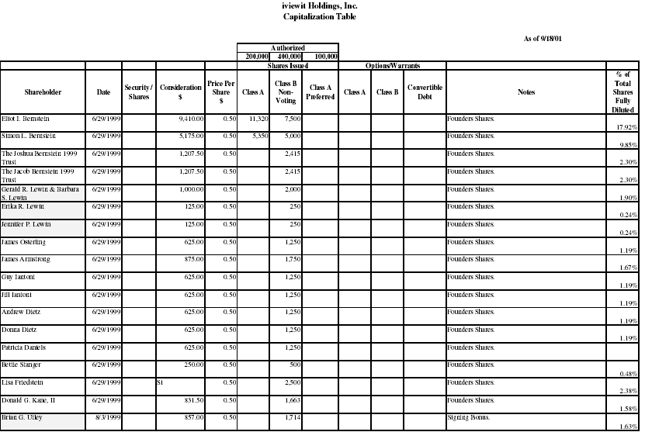
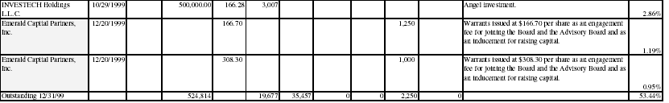
IVIEWIT SHAREHOLDER TABLE

Slide 42
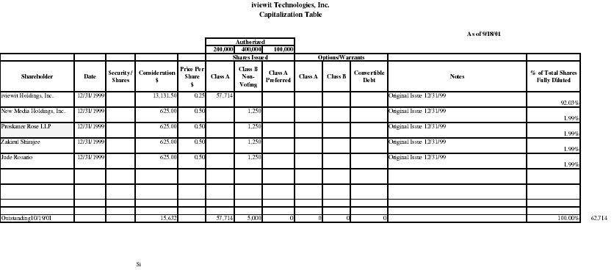
Proskauer Stock Holdings

Slide 43
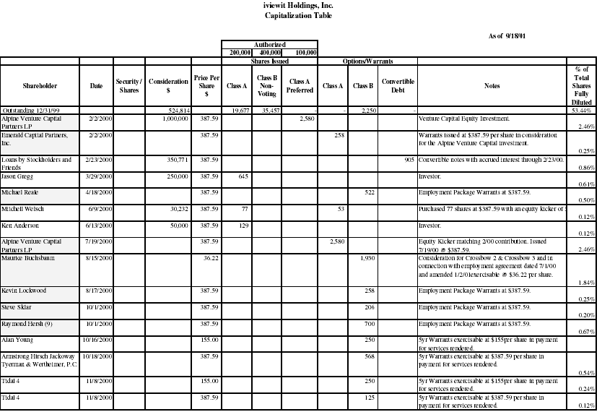

Slide 44
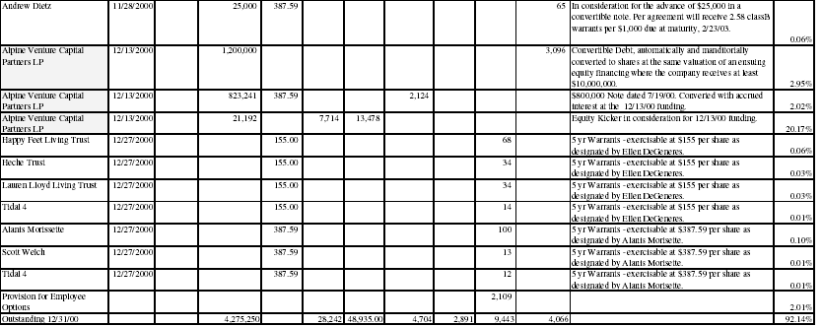

Slide 45
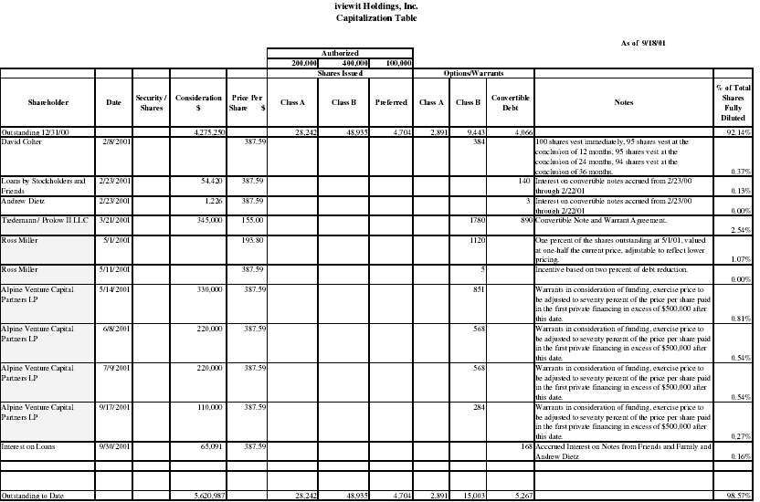

Slide 46
Patent Pool Members

Slide 47














Licensors – MPEG-2
Following is a list of licensors of patents included in the MPEG-2 Patent Portfolio License. Their commitment is to provide fair, reasonable, nondiscriminatory licensing of MPEG-2 technology's essential patents.
Philips Electronics
Sharp Corporation

Slide 48
Licensees
  AAV Australia Pty Ltd Access Media S.P.A. Action Asia Limited Action Duplication Inc.
  Action Electronics Co., Ltd. Action Industries (M) SDN. BHD. Acoustic Systems, Inc. AdCoCom GmbH
  Addonics Technologies, Inc. ADI Corporation Adspace Networks, Inc. AEON Digital Corp
  Aeroflex Lintek, Inc. AgileTV Corporation Ahead Software AG Ahead Software Incorporated
  Airshow, Inc. Aiwa Co., Ltd. Alcatel Alco Digital Devices Limited
  Alcorn McBride, Inc. Alienware Corporation Alienware Limited Alpine Electronics, Inc.
  AMLOGIC, Inc. Amnis Systems Inc. Amphion Semiconductor (Asia) Limited
  Amphion Semiconductor Inc. Amphion Semiconductor Limited Amstrad plc AMX
  AnalyTotal Ltd. AOL Time Warner Inc. APIM Informatique S.A.R.L. Aplus Technics Co., Ltd.
  Apollo Electronics Group Limited Apple Computer, Inc. A&R Cambridge Limited Arima Computer Corp.
  ASC Audio Video Corporation ASE Technologies, Inc. Astrodesign, Inc. ATL Electronics (M) Sdn. Bhd.
  ATL Hong Kong Limited ATLM Taiwan Inc. Audiovox Electronics Corporation Autodesk, Inc.
  Axis Communications AB Bang & Olufsen A/S Bashaw, Sean Beautiful Enterprise Co., Ltd
  BennArts B.H.A. Corporation Billionton Systems Inc. BitCtrl Systems GmbH
  Blonder Tongue Laboratories, Inc. Bose Corporation Broadcast Sports Inc. Broadcast Technology Limited
  B.U.G., Inc. BUFFALO INC. Canon Inc. Casio Computer Co., Ltd.
  C-Cube Microsystems, Inc. CD Linja, Digital Communication Media Oy CellStack Systems Ltd
  CenDyne, Inc. Cequadrat (USA), Inc. CGI Verwaltungsgesellschaft mbH Cheertek Inc.
  Chumiecki, Tomasz J. Cine Magnetics Video & Digital Laboratories CineForm, Inc.
  Cinram France, S.A. Cinram Inc. Cinram International Inc. Cinram Latinoamericana S.A. de C.V.
  Cinram Nederland B.V. Cinram Optical Discs, S.A. Cinram U.K. Ltd. Cirrus Logic Inc.
  CIS Technology Inc. Cisco Australia Cisco Canada Cisco Japan
  Cisco Systems BV and Cisco Systems Capital BV Cisco Systems Capital Cisco Systems, Inc.
  Clarion Co., Ltd. Codex Novus, Inc. Columbia Digital Media, Inc. Compaq Computer Corporation
  Computational Engineering International Computer Modules, Inc. Cornet Technology, Inc. Coull Limited
  Custom Technology Corporation CyberLink Corp. Cyrus Electronics Ltd. D&M Holdings, Inc.
  d+p GmbH Daewoo Electronics Corporation Dai Hwa Industrial Co., Ltd. Darim Vision Co.
  Data Becker GmbH & Co. KG Dataton Utvecklings AB DCM Danmark, Digital Communication Media Aps
  DCM Sweden, Digital Communication Media AB DCM TriData, Digital Communication Media AB

Slide 49
  DEFINITION Consultants Ltd. Delco Electronics Corporation DELL Products, L.P. DENON, Ltd.
  Denon Electronic GmbH Digatron Industrie-Elektronik GmbH DigiOn, Inc. Digital Audio Disc Corporation
  Digital Communication Media AB Digital Media Technologies, Ltd. Digital Networks North America, Inc. Digital Transmission Equipment
  Digital Video Services Digital Vision AB Digitalfabriken Göteborg, Digital Communication Media AB
  Diotech SMT Product Co., Ltd. Direct Broadcasting Satellite Corporation DirectSat Corporation
  Disctronics Manufacturing (UK) Limited Dish Entertainment Corporation Dish Factory Direct Corporation Dish, Ltd.
  DIVA Systems Corporation DivXNetworks, Inc. (DIVX) Doremi Labs, Inc. Drastic Technologies Ltd.
  DResearch Digital Media Systems GmbH D.S. Corporation DVD Retail Ltd. (Mirror) DX Antenna Co., Ltd.
  Eastern Asia Technology Limited Eastwin Technology Inc Eastwin Technology Industries (Hui Yang) Co. Ltd.
  Easy Systems Japan Ltd. Echonet Business Network, Inc. Echosphere Corporation Echosphere De Mexico S.De R.L. De. C.V. EchoStar Acceptance Corporation EchoStar Communications Corporation
  EchoStar DBS Corporation EchoStar Indonesia Corporation EchoStar International Corporation EchoStar International (Maritius Limited) EchoStar KuX Corporation EchoStar Manufacturing and Distribution Private Limited (India)
  EchoStar North America Corporation EchoStar PAC Corporation EchoStar Real Estate Corporation EchoStar Real Estate Corporation II
  EchoStar Satellite Broadcasting Corporation EchoStar Satellite Corporation EchoStar Space Corporation EchoStar Technology, Inc.
  ECM Systems Ltd. EDGE Co., Ltd. EG Technology, Inc. ek3 Technologies Inc.
  Elma Ingénierie Informatique EMI Global, Inc. EMI Recorded Music Enlight Corporation
  Enseo, Inc. E-Sat, Inc. E-Soft Computer Co., Ltd. ESBuy.com
  ESDG Konsult AB Etronics Corporation EuroNimbus S.A. Evatone, Inc.
  Exatel Visual Systems, Inc. FineArch Inc. First Virtual Communications, Inc. Flextracker Sdn. Bhd.
  Formation, Inc. Frey Technologies, LLC Fujitsu Limited Fujitsu Siemens Computers
  Fujitsu Siemens Computers AB Fujitsu Siemens Computers AG Fujitsu Siemens Computers AS Fujitsu Siemens Computers A/S
  Fujitsu Siemens Computers BV Fujitsu Siemens Computers d.d. Fujitsu Siemens Computers GmbH Fujitsu Siemens Computers KFT
  Fujitsu Siemens Computers Ltd Fujitsu Siemens Computers Oy Fujitsu Siemens Computers (Pty) Ltd Fujitsu Siemens Computers s.r.o.
  Fujitsu Siemens Computers SA Fujitsu Siemens Computers SL Fujitsu Siemens Computers SP. z.o.o. Fujitsu Siemens Computers SpA
  FUJITSU TEN LIMITED Funai Electric Co., Ltd. Futic Electronics Ltd Gateway, Inc.

Slide 50
  GBM Advanced Technology International Inc. General Instrument Corporation Generic Media Inc.
  GENIX InfoComm Co., Ltd. Global Web TV, Inc. GPX, Inc. Grass Valley (US) Inc.
  Great Wall Digitech Limited GRUNDIG AG Gyro Media AB Gyro Soft AB
  Harman International Industries/Madrigal Audio Laboratories, Inc. Harmonic Inc. Harvests Multimedia Pte Ltd.
  Heim Systems GmbH Helius Inc. Heuris Logic Incorporated Hewlett-Packard Company
  Hibino Data-com Co., Ltd. High Speed Video Inc. Hitachi Business Solutions Co., Ltd. Hitachi Communication Systems, Incorporated Hitachi Electronics Engineering Co., Ltd. Hitachi Electronics Products (Malaysia) Sdn. Bhd. Hitachi Engineering Co., Ltd. Hitachi Home Electronics (America), Inc.
  Hitachi Home Electronics (Europe), Ltd. Hitachi Hometec, Ltd. Hitachi Information Systems, Ltd. Hitachi Kokusai Electric Inc.
  Hitachi, Ltd. Hitachi SK Social System Co., Ltd. Hitachi Software Engineering America, Ltd.
  Hitachi Software Engineering Co., Ltd. Hitachi Software Engineering Europe S.A. Hitachi Software Global Technology, Ltd. Hitachi Technology (Taiwan) Ltd. Hitachi Telecom Technologies, Ltd. Hong Kong Tohei E.M.C. Co., Ltd.
  Houston Tracker Systems, Inc. HT Ventures, Inc. Hughes Network Systems Hui Yang Eastway Electronics Co., Ltd
  HUMAX Co., Ltd. HUMAX Electronic Ltd. Hyunwoo McPlus Co., Ltd. IBE, Inc.
  Ikegami Tsushinki Co., Ltd. Imagination Technologies Limited Imedia Corporation iMPath Networks, Inc.
  IMS international media service spa Independent Masters Ltd. Indoor Outdoor Entertainment, S.A. InfoValue Computing, Inc.
  Infocity, Inc. Innobits AB Innovision Limited Institut fuer Rundfunktechnik GmbH
  International Antex, Inc. International Fiber Systems, Inc. International Image Services Corp. doing
  business as Sonic Foundry Media Services International PADI, Inc. Interra Digital Video Technologies InterVideo, Inc.
  Inventec Electronics (M) Sdn. Bhd. iZotope, Inc. Japan Communication Equipment Co., Ltd.
  Japan Digital Laboratory Co., Ltd. Japan Radio Co., Ltd. Japan Wave Inc. Jaton Computer Co., Ltd.
  Jeppesen Sanderson, Inc. JEPRO Co., Ltd. J Hepple, Incorporated Jin Shen Long Electronics (Shen Zhen) Co., Ltd Kabushikigaisya Fujiyadenki Seisakusyo Kaleidescape Canada, Inc.
  Kaleidescape, Inc. Kalyani Sharp India Limited kdg France SAS kdg mediatech AG
  kdg netherlands BV kdg uk Ltd Kent World Co., Ltd Kenway Technology Industries (Hui Yang) Co. Ltd. Kenwood Corporation Kinki General Service Co., Ltd. Koninklijke Philips Electronics N.V.
  Krell Industries, Inc. KTech Telecommunications, Inc. KUME Electric Corporation L-3 Communications Systems West
  Lawrence Livermore National Laboratory Leica Geosystems GIS & Mapping, LLC Leitch Europe Limited
  Leitch Incorporated Leitch Technology Corporation Leitch Technology International Inc. LG Electronics Inc.
  Lidcom Limited LifeScience Media Lindows.com, Inc. Linear Systems Ltd.
  Link Research Ltd. Linn Products Limited LOEWE OPTA GmbH Logic Innovations, Inc.
  Logitec Corporation LOGOS Ljud och Bild Produktion AB Long Lived e-Computer Technologies Co., Ltd.
  LSI Logic Corporation LSI Systems Inc. Lu Kee Electronic Company Limited LuxSonor Semiconductors, Inc.
  MacroSystem Digital Video AG MacroSystem France S.A.S. MacroSystem Schweiz AG MacroSystem US, Inc.
  MainConcept GmbH MainConcept LLC MANSEI Corporation Manufacturing and Test Co., Inc. dba MATCO Manystreams, Inc. Manzanita Systems Marantz Japan, Inc.

Slide 51
  Marconi Communications, Inc. Mark Gunning Mars Technologies, Inc. Maspro Denkoh Corporation
  Matsushita Electric Industrial Co., Ltd. Matsushita Electric (Taiwan) Co., Ltd. Matsushita Electric (U.K.) Ltd. Matsushita Electronics Corporation
  Matsushita-Kotobuki Electronics Industries, Ltd. Matsushita Kotobuki Electronics Industries of America Inc.
  Matsushita Kotobuki Electronics Sales of America, LLC. MAX Internet Communications, Inc. MAXpc Technologies, Inc.
  McIntosh Laboratory Media Compression LLC Media Excel, Inc MediaWare Solutions Pty Ltd.
  MedioStream, Inc. Memory-Tech Corporation Meridian Audio Limited Metatec International, Inc.
  Metz-Werke GmbH & Co KG Micro Application SA Micro Solutions Inc. MicronPC, LLC
  Micron Government Computer Systems, LLC Microtune (Texas), L.P. MidStream Technologies, Inc. Minerva Networks, Inc.
  Mintek Digital Inc. MIT Media Lab Mitsubishi Electric Corporation Mokoh & Associates, Inc.
  Moonlight Cordless Ltd. Motorola MPO MRT Technology LLC
  Multimedia Technologies, Inc. muvee Technologies Pte. Ltd. NagraStar LLC Naim Audio Ltd.
  Namsung Corporation Nanjing Sharp Electronics Co., Ltd. National Semiconductor Corporation NCR Corporation
  NCT AG NDS Limited Neil Galton Consultancy Ltd Neos Interactive Ltd.
  NewSoft Technology Corporation Next Level Communications, Inc. NIHON COMPUTER Co., Ltd. Nihon Digital Consumer Electronics Corporation Nikko Denki Tsushin Corporation Nimbus Manufacturing, Inc. Nimbus Manufacturing (UK) Ltd.
  Nokia Corporation by and through it's business unit Nokia Home Communications Norcent Technology Inc.
  NTK Computer Inc. NTT Advanced Technology Corporation NTT Broadband Initiative Inc.
  NTT Electronics Corporation Nuon Semiconductor, Inc. Oak Technology, Inc. Oki Electric Industry Co., Ltd.
  ONKYO CORPORATION ONKYO ELECTRONICS CORPORATION ONKYO EUROPE ELECTRONICS GmbH ONKYO INDIA PVT. LTD ONKYO (MALAYSIA) SDN. BHD ONKYO U.S.A. CORPORATION
  Optibase B.V. Optibase Europe Optibase Inc. OPTIBASE LTD.
  Optical Experts Manufacturing, Inc. (OEM) OptiDisc Solutions, LLC Orion America, Inc. Orion Electric Co., Ltd.
  Orion Electric (U.K.) Ltd. PAC Interactive Technology, Inc. P. Guerra s.r.l. Pace Micro Technology PLC
  Padus, Inc. Panasonic Automotive Systems Company of America Panasonic AVC Networks America, a Division of Matsushita Electric Corporation of America Panasonic AVC Networks Australia Pty. Ltd.
  Panasonic AVC Networks Germany GmbH Panasonic AVC Networks Singapore Pte Ltd Panasonic Communications Co., Ltd.
  Panasonic Digital Network Serve Inc. Panasonic Disc Manufacturing Corporation of America Panasonic Mobile Communications Co., Ltd. Panoramic Media PC DTV Technologies, LLC
  pcHDTV Inc. Pegasus Communications Pegasys Inc. Photodex Corporation
  PictureToTV.com Pte Ltd. Pioneer Corporation Pioneer Electronics Manufacturing (Shanghai) Co., Ltd.
  Pioneer Electronics Technology (U.K.) Ltd. Pioneer Technology (Malaysia) SDN, BHD Pioneer Video Corporation

Slide 52
  Pioneer Video Manufacturing Inc. Plat’C2, Inc. Popwire Stockholm AB Pozzoli S.p.A
  Private Eye Productions Prostar Computer, Inc. Proton Co., Ltd. Softboat Division Company
  Provideo Multimedia Co. Ltd. Proximity Pty Ltd PT Matsushita Kotobuki Electronics Industries Indonesia
  Pure Motion Ltd Questin' Studios Radyne ComStream RATOC Systems, Inc.
  Regency Recordings Pty Ltd. Research Systems, Inc. Rohde & Schwarz GmbH & Co. KG Roxio ApS
  Roxio CI Ltd. Roxio GmbH & Co. KG Roxio, Inc. Roxio International B.V.
  Roxio Japan Inc. S.A.D. GmbH S. Anbu Ezhilan Salent Technologies Ltd.
  Sampo Corporation Samsung Electronics Co., Ltd. SANYO Electric Co., Ltd. Sanyo Laser Products, Inc.
  SANYO Manufacturing Corporation SANYO Technosound Co., Ltd. Sasken Communication Technologies Limited
  Satellite Source, Inc. Satrec Mauritius Limited Scheidt & Bachmann GmbH sci-worx GmbH
  Science Applications International Corporation Scientific-Atlanta Europe n.v. Scientific-Atlanta, Inc.
  Scopus Network Technologies Ltd. sedima AG Sensoray Company, Inc. Sensory Science Corporation
  Serif Europe Limited Shanghai Far Year Technology Co., Ltd. Sharp Corporation
  Sharp Electronica Espana S.A Sharp Electronica Mexico S.A. de C.V. Sharp Manufacturing Company of America Sharp Manufacturing Company of U.K. Sharp Manufacturing Corporation (M) Sdn. Bhd. Sharp-Roxy Appliances Corporation (M) Sdn. Bhd. Sharp-Roxy Electronics Corporation (M) Sdn. Bhd. Sharp Thebnakorn Manufacturing Shenzhen Action Electronics Co., Ltd.
  Shenzhen Kaixinda Electronics Co. Ltd. Shenzhen Landel Electronics Tech. Co., Ltd. Shin Won Industry Co., Ltd.
  Silicon Construction Sweden AB Silicon Motion, Inc. Simflex Software SkyStream Networks Inc.
  Smith & Nephew, Inc. Endoscopy Division S.N.A. (Société Nouvelle Aréacem) Snell & Wilcox Limited Sonic Foundry, Inc.
  Sonic Foundry Media Services, Inc. Sonic Foundry Systems Group, Inc. Sonic Solutions Sonista, Inc.
  Sonopress Iber-Memory, S.A., Spain Sonopress, Inc., USA Sonopress Ireland Limited Sonopress Mexico Una division de BMG Entertainment Mexico S.A. de C.V. Sonopress Pan Asia Ltd. Sonopress Produktionsgesellschaft für Ton-und Informationsträger
  Sonopress Rimo Indústria e Comércio Fonográfica Ltda Sonopress Singapore PTE LTD Sony Computer Entertainment Inc.
  Sony Corporation Sony DADC Austria AG Sony Electronics Inc. Sony Music Entertainment (Hong Kong) Ltd. Sony Music Entertainment (Japan) Inc. Sony Music Entertainment Mexico, S.A. C.V.
  Sony Pictures Digital Inc. Sony Service Center (Europe) NV Sony United Kingdom, Ltd. Sord Computer Corporation
  Sorenson Media, Inc. Sourcenext Corporation Spectaculaire! Spellings Computer Services Ltd.

Slide 53
  Sports Training Media S & T Systemtechnik GmbH Standard Communications Corp. Starlight Video Limited
  Star Video Duplicating Stebbing Recording Centre Ltd Strategy & Technology Ltd. Stream Machine Company
  Stumpfl GmbH Sumitomo Electric Industries, Ltd. Summit CD Manufacture Ptd Ltd Summit Hi-Tech Pte Ltd
  Sunimage Studios Inc. Swedish Customs Service Syntermed, Inc. TAG McLaren Audio Limited
  Taisei Electronics Co., Ltd. TAKT Kwiatkowski i Miadzel sp. j. Tandberg Television ASA Tatung Co.
  TDK Electronics Corporation TDK Recording Media Europe S.A. TEAC America, Inc. TEAC Corporation
  TEAC DEUTSCHLAND GmbH TEAC SYSTEM CREATE CORPORATION Technicolor Disc Services Corporation
  Technicolor Home Entertainment Services Ireland Ltd. Technicolor Mexicana, S. de RL de CV Technicolor Pty Ltd.
  Technicolor Videocassette, Inc. TechniSat Digital GmbH TechnoScope Co., Ltd. TechnoTrend AG
  Techsan I&C Co., Ltd. Tekniche Limited Tektronix Cambridge Limited Tektronix, Inc.
  Telecom Kiki, Ltd. Teledac Inc. Teleview Terr, LLC dba 321 Studios
  The Mireth Technology Corporation THOMSON THOMSON Broadband UK Ltd. THOMSON Digital Europe
  THOMSON multimedia Asia Pacific Pte Ltd THOMSON multimedia Hong Kong Ltd.
  THOMSON multimedia Inc. THOMSON multimedia Operations (Thailand) Co. Ltd.
  THOMSON multimedia Polska Sp. Z o.o. THOMSON Sales Europe S.A. THOMSON Television Angers S.A. THOMSON TUBES & DISPLAYS S.A. TiVo, Inc. Tonic Digital Products Limited Toppan Printing Co., Ltd.
  Toshiba America Information Systems, Inc. Toshiba Computer Systems (Shanghai) Co., Ltd. Toshiba Corporation
  Toshiba Europe GmbH Toshiba Information Systems (UK) Limited TOSHIBA TEC CORPORATION
  TOSHIBA VIDEO PRODUCTS PTE LTD Total Technology Co. Ltd. TOTTORI ONKYO CORPORATION Tottori SANYO Electric Co., Ltd.
  Trilogic Troll Technology Corporation TTirem, Inc. dba Meritt Electronics Twelve Tone Systems, Inc. dba Cakewalk UEC Technologies (Pty) Ltd. UnLimiter Limited UP Technology Co., Ltd.
  U.S. Philips Corporation VBrick Systems, Inc. VCS Video Communication Systems AG
  Vela Research LP Vestel Komunikasyon San. Tic. A. S. Victor Company of Japan, Limited VideoTele.com, Inc.
  Visionary Solutions Inc. Visteon Corporation VITEC MULTIMEDIA VITEC MULTIMEDIA Inc
  VOB Computersysteme GmbH V.T.V. NV WACOM Europe GmbH Welton Electronics Limited
  Wescam Europe Limited Wescam Inc. Wescam Incorporated Wescam LLC
  Wescam Sonoma Inc. Wiagra Winbond Electronics Corp. WIS Technologies, Inc.
  Womble Multimedia, Inc. World Electric (Thailand) Ltd. Wuxi Multimedia Limited XION GmbH
  Xzeos Software Sarl Ya Bang Industrial Co., Ltd. Yamaha Corporation Yamaha Electronics Manufacturing (M) SDN.BDH. Yanion Company Limited Yung Fu Electrical Appliances Corp., Ltd.
  Yokogawa Electric Corporation Zapex Technologies, Inc. ZapMedia.com, Inc. Zenith Electronics Corporation
  Zhongshan KenLoon Digital Technology Co., Ltd. Zirbes, Kelly ZOO Digital Group plc

Slide 54

MPEG 4 – Visual Licensors
Following is a list of licensors of patents included in the MPEG-4 Visual Patent Portfolio License. Their commitment is to provide fair, reasonable, nondiscriminatory licensing of MPEG-4 Visual technology's essential patents.
Canon, Inc.
Curitel Communications, Inc.
France Télécom, société anonyme
Fujitsu Limited
GE Technology Development, Inc.
General Instrument Corporation
Hitachi, Ltd.
KDDI Corporation
Koninklijke Philips Electronics N.V.
Matsushita Electric Industrial Co., Ltd.
Microsoft Corporation
Mitsubishi Electric Corporation
Oki Electric Industry Co.
Samsung Electronics Co., Ltd.
SANYO Electric Co., Ltd.
Sharp Kabushiki Kaisha
Sony Corporation
Telenor Communication II AS
Toshiba Corporation
Victor Company of Japan, Ltd.

Slide 55

Ahead Software AKI Digital Electrical Appliance Co., Ltd.
Amont Security Products ANDI GmbH
Anystream, Inc. AutoTOOLS Group Co., Ltd.
BroadQ, LLC Canon, Inc. Carry Computer Eng. Co., Ltd
10.Casio Computer Co., Ltd. Casio Soft Co., Ltd.
12.Cezy International Limited
46.Kyocera Wireless Corp.
47.LG Electronics, Inc.
48.Matsushita Electric Industrial Co., Ltd.
49.Matsushita Kotobuki Electronics Industries, Ltd.
50.Media Excel, Inc.
13.Chowsons International Inc.
14.Cinapse Networks Co., Ltd.
15.Cisco Systems, Inc.
16.Cloanto Italia srl
17.Codex Novus, Inc.
18.Crypton Future Media, Inc.
19.Curitel Communications, Inc.
20.dicas digital image coding GmbH
21.DivXNetworks, Inc.
22.E-Genie Australia Pty. Ltd.
23.eAcceleration Corp
24.Eastern Asia Technology Limited
25.Eastman Kodak Company
26.Endocardial Solutions, Inc.
27.Enlight Corporation
28.Fandango, Inc.
29.Fraunhofer-Gesellschaft zur Foerderung der Angewandten Forschung e.V.
30.Fujitsu Limited
31.G-Star Communications Inc.
32.General Instrument Corporation
33.Guangzhou Panyu Juda Car Audio Equipment Co. Ltd.
34.High Tech Computer Corp.
35.Hitachi Ltd.
36.Hitachi Hybrid Network Co., Ltd.
37.IndigoVision Limited
38.Intercube Co., Ltd.
39.iVAST Inc
51.Megachips Corporation
52.Microsoft Corporation
53.Mitsubishi Electric Corporation
54.NEC Corporation
55.NEC CustomTechnica, Ltd.
56.Neos Interactive Limited
57.Nextreaming Corp.
58.Nokia
59.NTT Electronics Corporation
60.Oki Electric Industry Co., Ltd.
61.PacketVideo Corporation
62.Panasonic Communications Co. , Ltd
63.Panasonic Mobile Communications Co., Ltd.
64.Photodex Corporation
65.Plala Networks, Inc.
66.Pony Canyon Inc.
67.Popwire Stockholm AB
68.PT Matsushita Kotobuki Electronics Industries Indonesia
69.Rhythmication Co., Ltd.
70.Samsung Electronics Co., Ltd.
71.SANYO Electric Co., Ltd.
72.Saver K.K.
73.Sercomm Corporation
74.Sharp Kabushiki Kaisha
75.Softel Limited
76.Sony Corporation
40.J Anime.com Co. Ltd.
41.KDDI Corporation
42.KDDI R&D Laboratories Inc.
43.KDDI Technology Corporation
44.Koninklijke Philips Electronics N.V.
45.Kyocera Corporation

Slide 56

MPEG 4 – Systems Licensors
Apple Computer, Inc.
Electronics and Telecommunications Research Institute (ETRI)
France Télécom, S.A.
Koninklijke Philips Electronics N.V.
Mitsubishi Electric Corporation
Samsung Electronics Co., Ltd.
Sun Microsystems, Inc.

Slide 57
List of MPEG LA, LLC's MPEG-4 Systems Licensees and Affiliates in good standing, based on information currently available to MPEG LA, LLC.
3ivx Technologies Pty. Ltd.
Ahead Software AG
Apple Computer, Inc.
Argo Interactive Ltd.
Casio Computer Co., Ltd.
Datafab Systems Inc.
Enlight Corporation
Fraunhofer-Gesellschaft zur Foerderung der Angewandten Forschung e.V.
GET/Telecom Paris
Intercube Co., Ltd.
Koninklijke Philips Electronics N.V.
LG Electronics
Media Excel, Inc.
Mitsubishi Electric Corporation
NeoMTel Co. Ltd.
Oki Electric Industry Co., Ltd.
PacketVideo Corporation
Premier Image Technology Corporation
Samsung Electronics Co., Ltd.
Sharp Corporation
Tai Guen Enterprise Co., Ltd.
VBrick Systems, Inc.
Victor Company of Japan,

Slide 58


DVD Patent Pool
Company Name
A & R Cambridge Limited A&G 22 International Trade Management Ltd.
Action Electronics Co., Ltd. ACTION INDUSTRIES (M) SDN. BHD.
Advanced Application Technology, Inc. AISIN AW CO., LTD.
Alco Digital Devices Limited ALPINE ELECTRONICS, INC.
Amoisonic Electronics Co., Ltd. APEX (JIANGSU) DIGITAL CO., LTD.
ATL ELECTRONICS (M) SDN., BHD. ATLM (HONG KONG) LIMITED
ATLM TAIWAN INC. BBK ELECTRONICS CORP., LTD.
Beautiful Enterprise Co., Ltd. BEHAVIOR TECH COMPUTER CORP
Beijing Golden Yuxing Electronics and Technology Co., Ltd.
California Audio Labs LLC Changzhou Linlong Electrical Appliance Co., Ltd. (China)
Changzhou Haojie Electric Co., Ltd. CHANGZHOU XINGQIU ELECTRONIC CO., LTD.
Chengzhi Wintel Digital Technology Co., Ltd.
CIS Technology Inc. Clarion Co., Ltd.
Cyrus Electronics Ltd. DENSO Corporation
DESAY A&V Science And Technology Co., Ltd.
DINGTIAN ELECTRONICS INDUSTRY CO., LTD.
DM Technology C0., Ltd. Dong Guan Evervictory Electronic Company Limited
Dongguan GVG Digital Technology Ltd. DongGuan, HuangJiang, Jing-Cheng electronics 9th plant
Dong Guan Lu Kee Electronic Factory Eastern Asia Technology Limited
EPO Science and Technology, Inc. First Technology International (H.K.) Co., Ltd.
First Technology International Co., Ltd. Force Norway A.S.
Foryou General Electronic Co., Ltd. Foxda Technology Industrial (Shenzhen) Co., Ltd.
FUJITSU TEN LIMITED FUNAI ELECTRIC CO., LTD.
Futic Electronics Ltd. Golden Take Ltd.
GP Electronics (Huizhou) Co., Ltd. GuangDong Nintaus Electronics Co., Ltd.
GUANGDONG XIN TIANLI ELECTRONICS CO., LTD
Guangzhou Durbang Yucharg Electronics Co., Ltd.
Guangzhou Huadu Koda Electronics Co., Ltd.
Guangzhou Panyu Juda Car Audio Equipment Co., Ltd.
GUANGZHOU ROWA ELECTRONICS CO., LTD.
Guangzhou Yiaou Pan Corporation Harman International Industries, Incorporated
Harman-Kardon, Incorporated Himage Holdings Limited
Hitachi Electronic Products (M) Sdn. Bhd. Hitachi Technology (Taiwan), Ltd
Hitachi, Ltd. Hitachi-LG Data Storage Korea, Inc.
Hitachi-LG Data Storage, Inc. HONG KONG TOHEI E.M.C. CO., LTD.
Sharp Roxy Electronics Corporation (M) SDN. BHD.
Shen Zhen Kaiser Electronic Co., Ltd. shengbangqiangdian Electronics (Shenzhen) Co., Ltd.
SHENZHEN ACTION ELECTRONICS CO., LTD.
SHENZHEN AKI DIGITAL ELECTRICAL APPLIANCE CO., LTD.
Shenzhen Bao'an Fuyong Jinfeng Electronics Co.
Copyright(C) 2002-2003 DVD 6C LICENSING AGENCY All Rights Reserved.

Slide 59
Shenzhen Contel Electronics Technology Co., Ltd.
SHENZHEN HANBAO SCIENCE & TECHNOLOGY INDUSTRIAL CO., LTD.
SHENZHEN KAIXINDA ELECTRONICS CO., LTD.
Shenzhen KXD Multimedia Co., Ltd. SHENZHEN LANDEL ELECTRONICS TECH CO., LTD.
Shenzhen SAST Electronics Co., Ltd SHENZHEN SHANLING ELECTRONIC CO., LTD.
SHENZHEN SHINELONG ELECTRONICS INDUSTRIAL CO., LTD.
Shenzhen Skywood Info-tech Industries Co., Ltd.
SHENZHEN Sogood DIRECTOR CO., LTD..
SHENZHEN SYNCHRON ELECTRONICS CO., LTD.
SHENZHEN Tenfull Digital Appliance co., ltd..
SHENZHEN TSINGHUA TONGFANG CO., LTD.
Shenzhen Xin Hongyu Digital Technology Co., Ltd.
Shenzhen Zhongcaixing Ele. co., Ltd. Shinano Kenshi Co., Ltd.
Shunde Xiong Feng Electric Industrial Company
Sinoca Enterprises (Zhong Shan) Co., Ltd. SKYWORTH Multimedia (Shenzhen) Co., Ltd.
South Jazz Electronics (Shenzhen) Co., Ltd.
Southwest Computer Co., Ltd. SOYEA TECHNOLOGY CO., LTD.
TAG McLaren Audio Limited TCL Technology Electronics (Hiuzhou) Co., Ltd.
TEAC Corporation TEAC Electronics (M) Sdn. Bhd.
Techsan I & C Co., Ltd. TOHEI INDUSTRIAL CO., LTD.
Toshiba Corporation Toshiba Information Equipment (Philippines), Inc.
Toshiba Multi Media Devices Co., Ltd. TOTTORI ONKYO CORPORATION
Tottori SANYO Electric Co., Ltd. Ultrastar Technology (shenzhen) LTD
UP Technology Co., Ltd. VICTOR COMPANY OF JAPAN, LTD
Visteon Corporation Welton Electronics Ltd.
Wuxi Multimedia Ltd. Xanavi Informatics Corporation
XIAMEN OVERSEAS CHINESE ELECTRONIC CO., LTD.,
Xiamen Suny Electronic Sound Co., Ltd. Ya Bang Industrial Co., Ltd.
YAMAHA CORPORATION YAMAHA ELECTRONICS MANUFACTURING (M) SDN, BHD
Yanion Company Limited Yung Fu Electrical Appliances Corp., Ltd.
Zhenjiang Jiangkui Group Co. ZHONGSHAN JOINTEK DIGITAL TECHNOLOGY LTD. ZHONGSHAN SHI NEON ELECTRONIC FACTORY LTD.

Slide 60
A6, Inc AAV Australia Pte. Ltd. AAV Duplication Replication & Logistics
ABLE Co., Ltd. Acmedia USA, inc. Action Duplication, Inc.
ADVANCED DIGITAL MEDIA Advanced Duplication Services, LLC AISIN AW CO., LTD.
ALMEDIO INC. AMC CO., LTD. Americ Disc Inc.
aod holland b.v. (advanced optical disc) Buhl Datenträger GmbH
CD Linja Digital Communication Media OY CDA Datenträger Albrechts
CDI (Compact Disc International) Ltd. CDI Media, Inc.
Cine Magnetics Video & Digital Laboratories Cinram International, Inc.
CMC Magnetics (HK) LTD. CMC Magnetics Corporation Concord Disc Manufacturing Corp.
Datapulse Technology Limited Datel Design & Development Ltd. DCM, Digital Communication Media AB
DECIBEL TRADING Srl Deluxe Media Services, Inc. Denon Digital, LLC
Deluxe Global Media Services France SARL Deluxe Global Media Services Italy SpA
Deluxe Global Media Services Limited Disctronics Texas Inc.
Duplico 2000 S.L. Ecofina srl EMI RECORDED MUSIC
EPO Technology of America, Inc. Europe Magnetics Corp. LTD. Evatone, Inc.
Extreme Digital Media Fuji Photo Film Co., Ltd. Future Media Productions, Inc.
GZ Digital Media a.s. GZ Recordable s.r.o. High Speed Video Inc.
Hitachi Maxell, Ltd. IMS international media service spa INFODISC TECHNOLOGY CO., LTD.
Infodisc Technology Korea Limited IPC Print Services, Inc.
JVC Disc America Company kdg France S.A. kdg mediatech AG
kdg Netherlands B.V. Kinki General Services Co., Ltd. KM Digital Media, Inc.
L & M optical disc LLC L & M optical disc west LLC Knob Ryder Entertainment
Matsushita Electric Industrial Co., Ltd. Matsushita Media Manufacturing de Mexico, S de R.L. de C.V.
Matsushita Media Manufacturing Ireland Matsushita Universal Media Services LLC of America
Maxell Corporation of America Maxell HI-Tech, Ltd. Maxwell Productions, LLC
McIntosh Laboratory, Inc. MEDIACOPY TEXAS, INC. Media Evolved, LLC
Memory-Tech Corporation Metatec International, Inc. icroservice Tecnologia Digital S.A.
MPO France S.A. National Film Labs (Crest National) NEC Corporation
OK Media Disc Service GmbH & Co. KG OMD Productions AG
Onken Corporation ODS Optical Disc Service GmbH (ODS) Optical Experts Manufacturing, Inc. (OEM)
OptiDisc Solutions LLC optimal media production GmbH Opti.me.s. S.p.A.
P + O Compact Disc GmbH Panasonic Disc Services Corporation Platinum Vision Group, LLC
POSO Media (Newstyle Media) Pozzoli Spa Prime Disc
Provac Disc Media Inc. Q Media Services Corp. QC Corporation
Quantum Optical Laboratories Group (QOL) Regency Recording Pty. Ltd.
Ritek Australia Pty. Limited Ritek Corporation SANYO Laser Products, Inc.
SDC Denmark a/s Sentinel N. V. Société Nouvelle Areacem (SNA)
Sonopress Ibermemory S.A. Sonopress Ireland Ltd. Sonopress LLC
Sonopress Produktionsgesellschaft für Ton-unt Informationsträger GmbH Sonopress Pte Ltd.
Summit Technology Australia Pty Ltd. Stebbing Recording Centre Limited
TAKT KWIATKOWSKI MIADZEL SPOLKA JAWNA The MEMOX Company
The Video Duplicating Co., Ltd. Time Warner Inc. Toppan Printing Co., Ltd.
Universal Manufacturing & Logistics GmbH U-Tech Media Corp.
VICTOR COMPANY OF JAPAN, LTD Videolar S.A.
Viduce B. V. Vigobyte De Mexico. S.A., De C.V. Viva Magnetics Limited
VTV Warner Music Manufacturing Europe GmbH. WEA Manufacturing Inc. (Warner Advanced Media Operations)
Zelenogradskiy Musical Technology Plant Zomax Incorporated

Slide 61
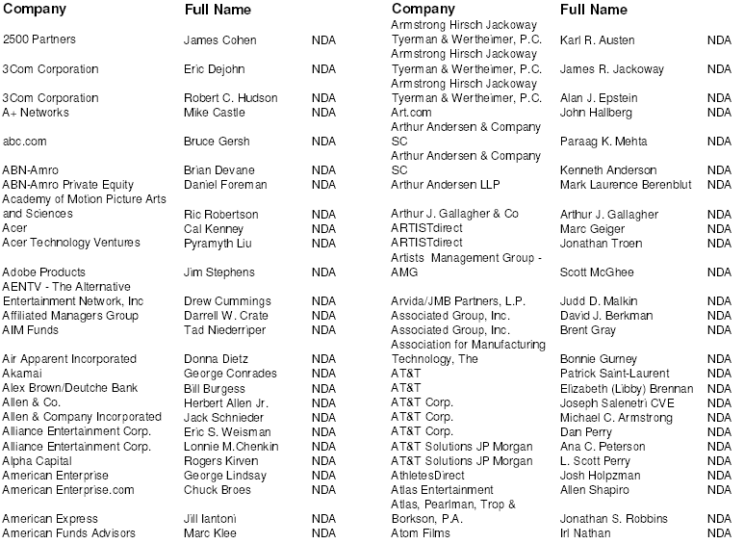
Iviewit Signed NDA’s

Slide 62
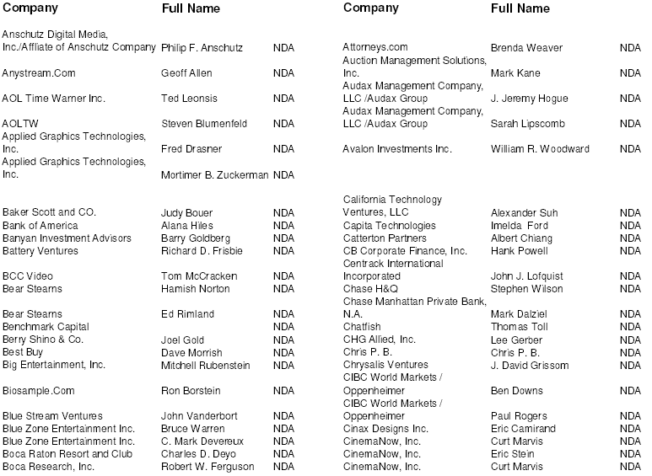

Slide 63
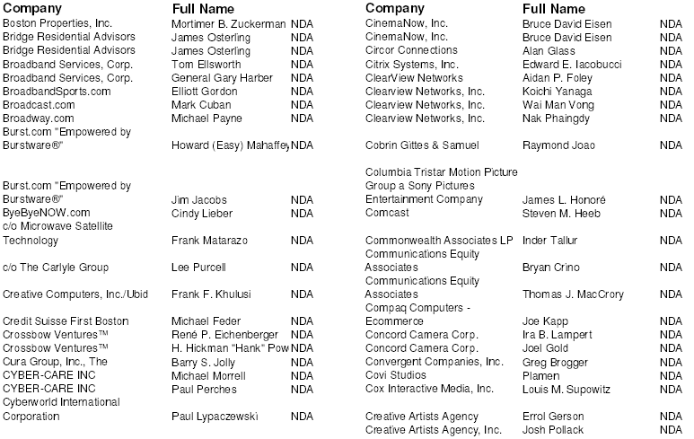

Slide 64
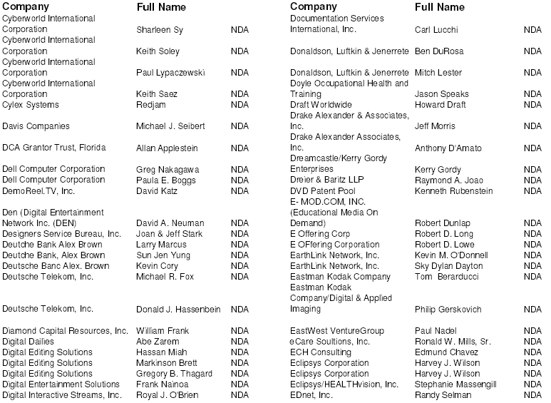

Slide 65
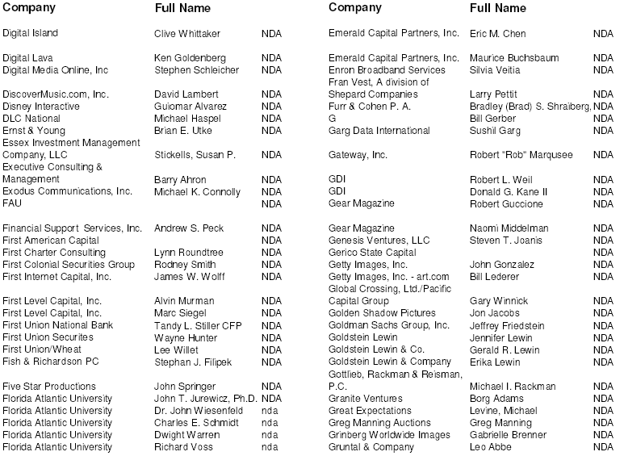

Slide 66
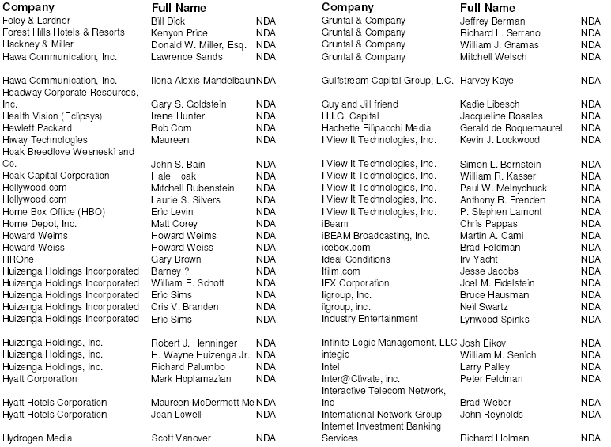

Slide 67
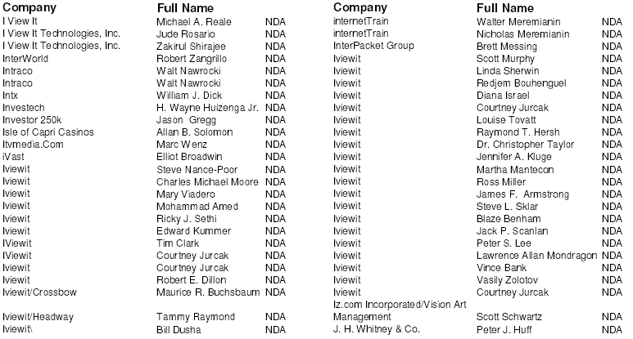

Slide 68
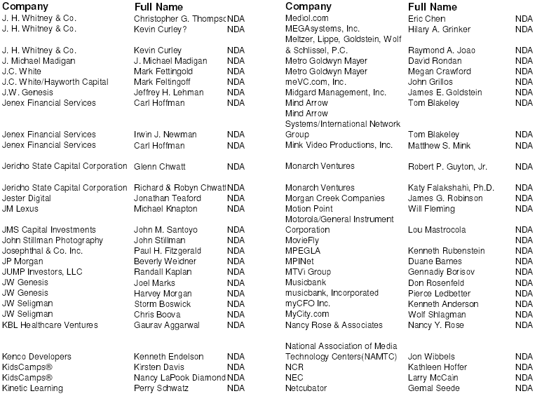

Slide 69
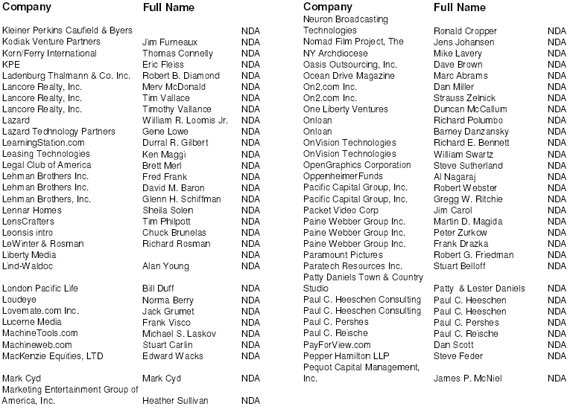

Slide 70
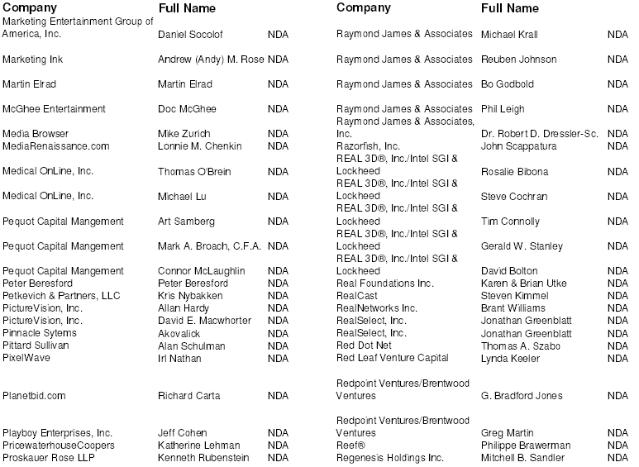

Slide 71
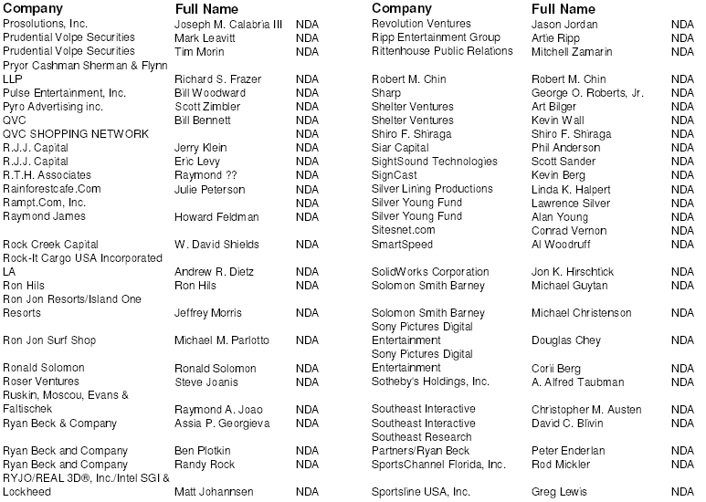

Slide 72
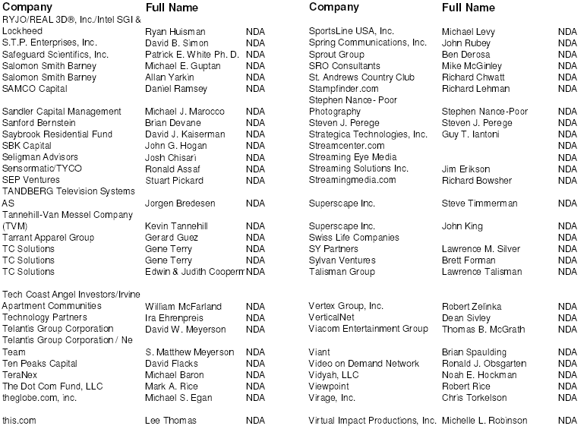

Slide 73
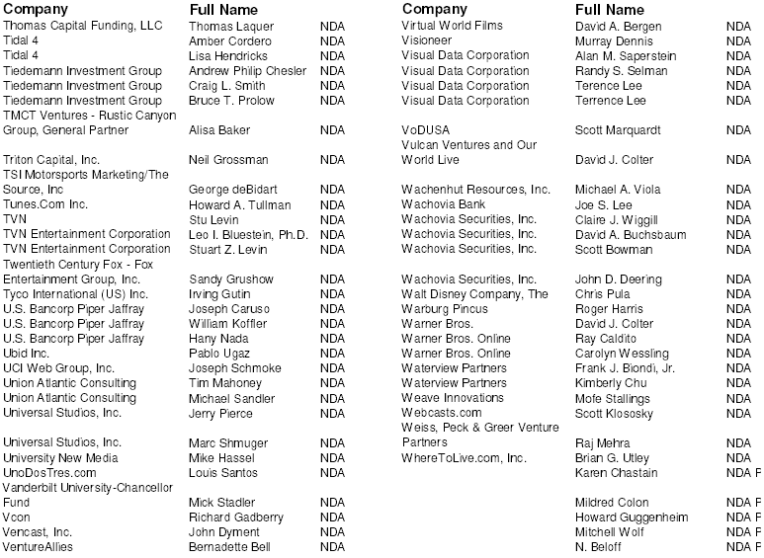

Slide 74
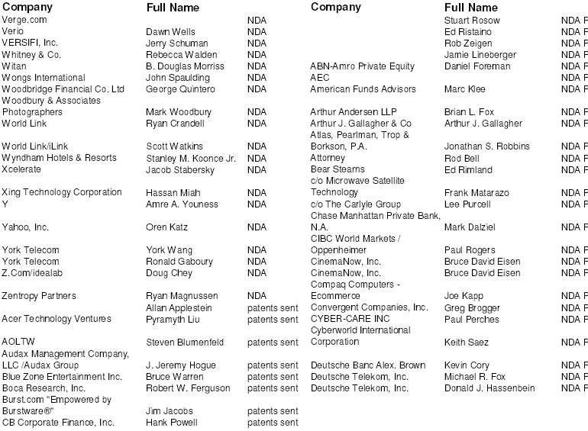

Slide 75
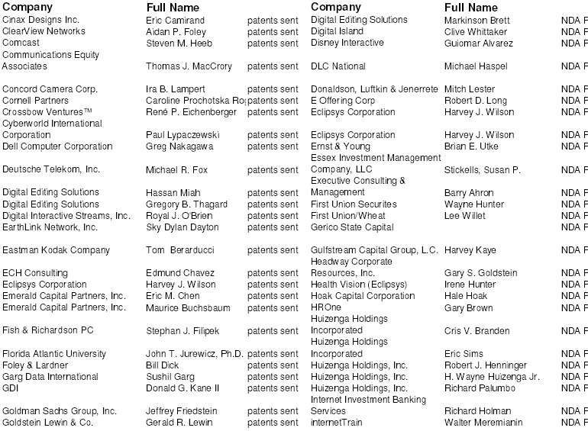

Slide 76
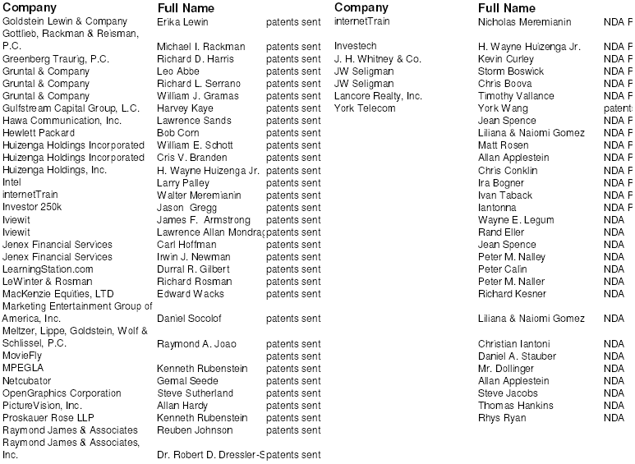

Slide 77
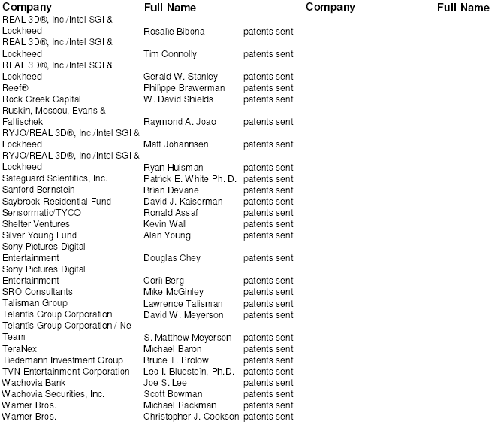

Slide 78
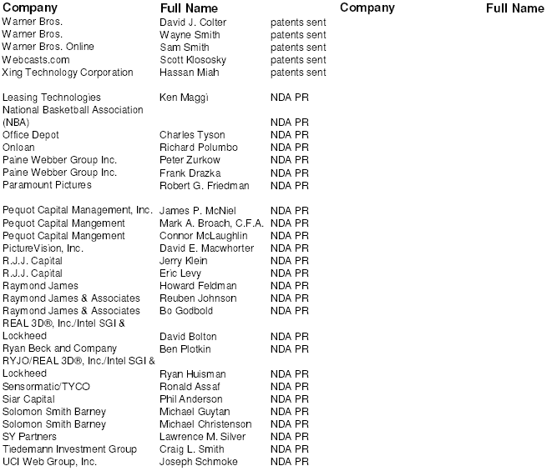

Slide 79
